Slide 1
Marching Triangles
Misha Kazhdan

Slide 2
Outline
Review
Goal
Interpolation
Implementation
Inductive triangulation

Slide 3
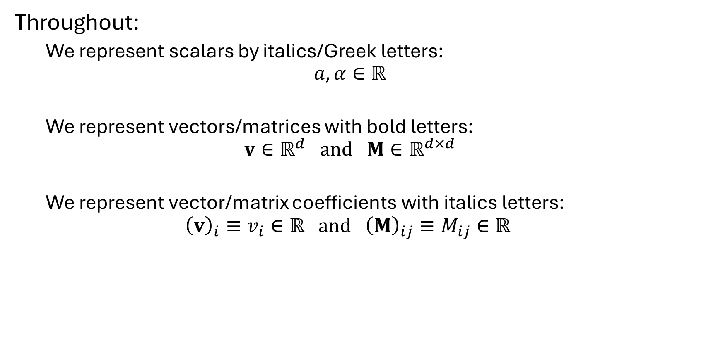
Notation
Throughout:
We represent scalars by italics/Greek letters:
$$a,α∈ℝ$$
We represent vectors/matrices with bold letters:
$$v∈ℝ^{d} and M∈ℝ^{d×d}$$
We represent vector/matrix coefficients with italics letters:
$${\left(v\right)}_{i}≡v_{i}∈ℝ and {\left(M\right)}_{ij}≡M_{ij}∈ℝ$$

Slide 4






Review: simplices in $ℝ^{d}$
$$(0,1)$$
$$𝕋^{d}$$
$$(0,0)$$
$$(1,0)$$
Definition:
The $d$-dimensional unit-right-simplex ${𝕋^{d}⊂ℝ}^{d}$ is the simplex through: $$\left\{\left(0,0,…,0,0\right),\left(1,0,…,0,0\right),\left(0,1,…,0,0\right),…,\left(0,0,…,1,0\right),\left(0,0,…,0,1\right)\right\}$$
$$⇕$$
$$𝕋^{d}=\left\{x=\{x_{1},…,x_{d}\}∈ℝ^{d} | 0≤x_{i}≤1, \sum_{i=1}^{d}{x_{i}}≤1\right\}$$

Slide 5
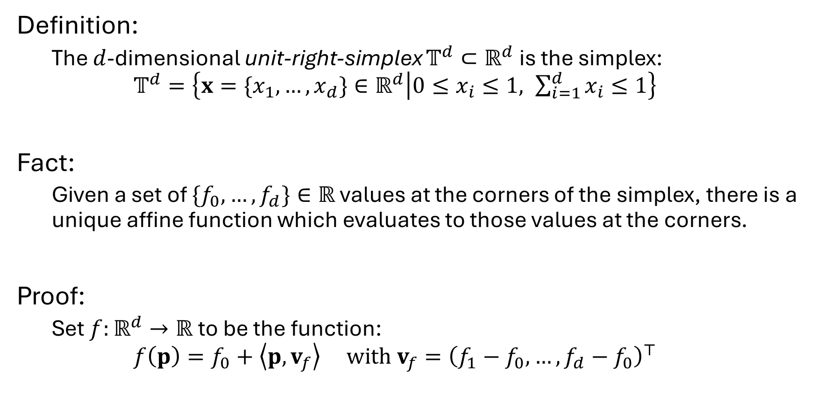
Review: simplices in $ℝ^{d}$
$$(0,1)$$
$$𝕋^{d}$$
$$(0,0)$$
$$(1,0)$$
Definition:
The $d$-dimensional unit-right-simplex ${𝕋^{d}⊂ℝ}^{d}$ is the simplex: $$𝕋^{d}=\left\{x=\{x_{1},…,x_{d}\}∈ℝ^{d} | 0≤x_{i}≤1, \sum_{i=1}^{d}{x_{i}}≤1\right\}$$
Fact:
Given a set of $\{f_{0},…,f_{d}\}∈ℝ$ values at the corners of the simplex, there is a unique affine function which evaluates to those values at the corners.
Proof:
Set $f:ℝ^{d}→ℝ$ to be the function: $$f\left(p\right)=f_{0}+\left\langle p,v_{f}\right\rangle with v_{f}={\left(f_{1}−f_{0},…,f_{d}−f_{0}\right)}^{⊤}$$

Slide 6





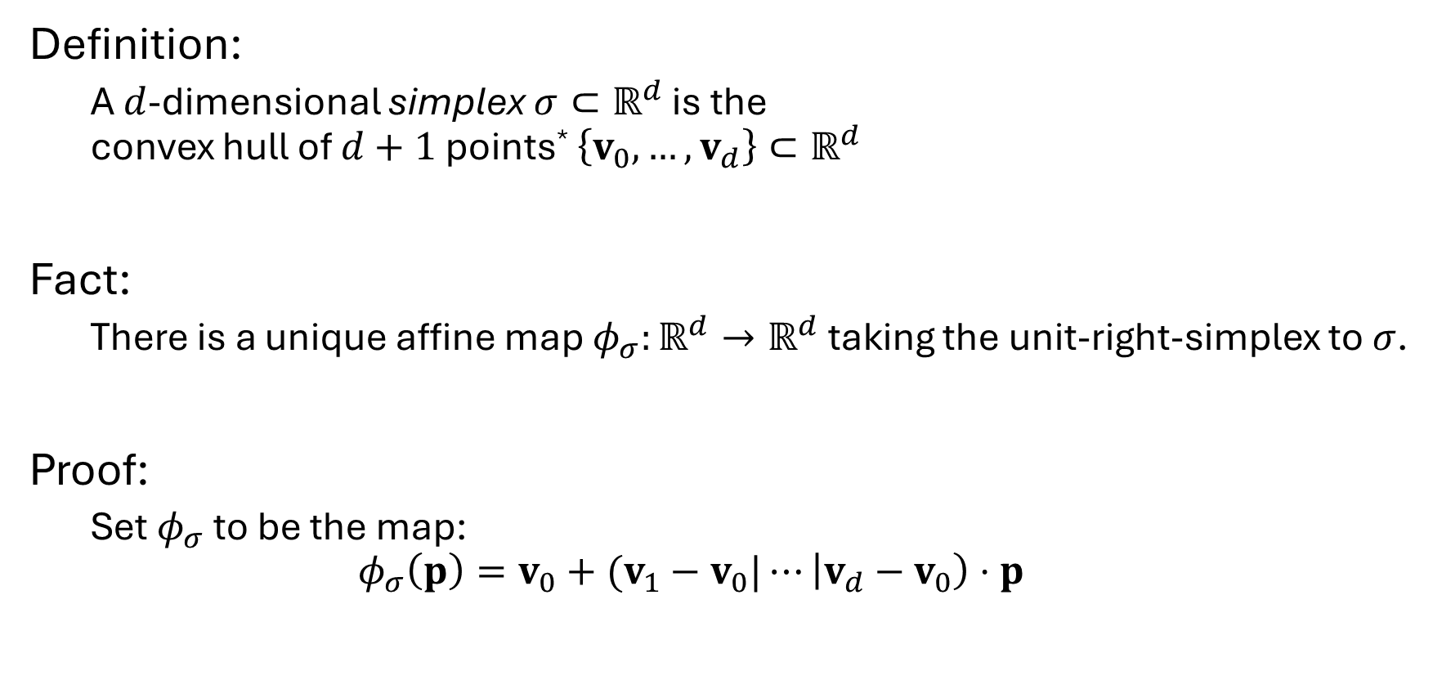
Review: simplices in $ℝ^{d}$
$$v_{2}$$
$$σ$$
$$v_{1}$$
Definition:
A $d$-dimensional simplex $σ⊂ℝ^{d}$ is the convex hull of $d+1$ points* $\left\{v_{0},…,v_{d}\right\}⊂ℝ^{d}$
Fact:
There is a unique affine map $φ_{σ}:ℝ^{d}→ℝ^{d}$ taking the unit-right-simplex to $σ$.
Proof:
Set $φ_{σ}$ to be the map: $$φ_{σ}\left(p\right)=v_{0}+(v_{1}−v_{0}|⋯\left|v_{d}−v_{0}\right)⋅p$$
$$v_{0}$$
*Throughout will be assuming that geometry is “in general position”
Notes:
General position in this case means that the the vectors $\{p_{i}−p_{0}\}$ are linearly independent

Slide 7
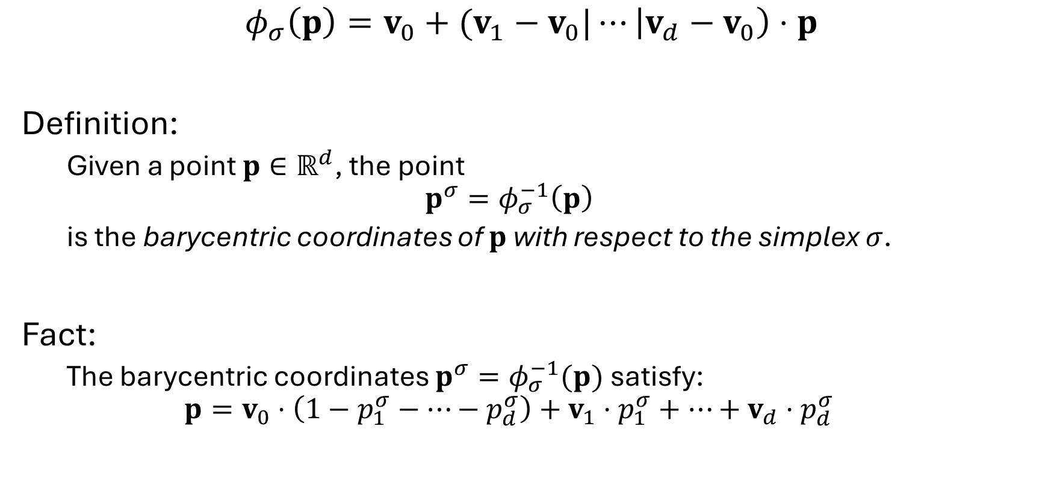
Review: simplices in $ℝ^{d}$
$$v_{2}$$
$$σ$$
$$v_{1}$$
$$φ_{σ}\left(p\right)=v_{0}+(v_{1}−v_{0}|⋯\left|v_{d}−v_{0}\right)⋅p$$
Definition:
Given a point $p∈ℝ^{d}$, the point
$$p^{σ}=φ_{σ}^{−1}\left(p\right)$$ is the barycentric coordinates of $p$ with respect to the simplex $σ$.
Fact:
The barycentric coordinates $p^{σ}=φ_{σ}^{−1}(p)$satisfy: $$p=v_{0}⋅\left(1−p_{1}^{σ}−⋯−p_{d}^{σ}\right)+v_{1}⋅p_{1}^{σ}+⋯+v_{d}⋅p_{d}^{σ}$$
$$v_{0}$$
Notes:
$$q=A^{−1}⋅(p−p_{0})$$

Slide 8


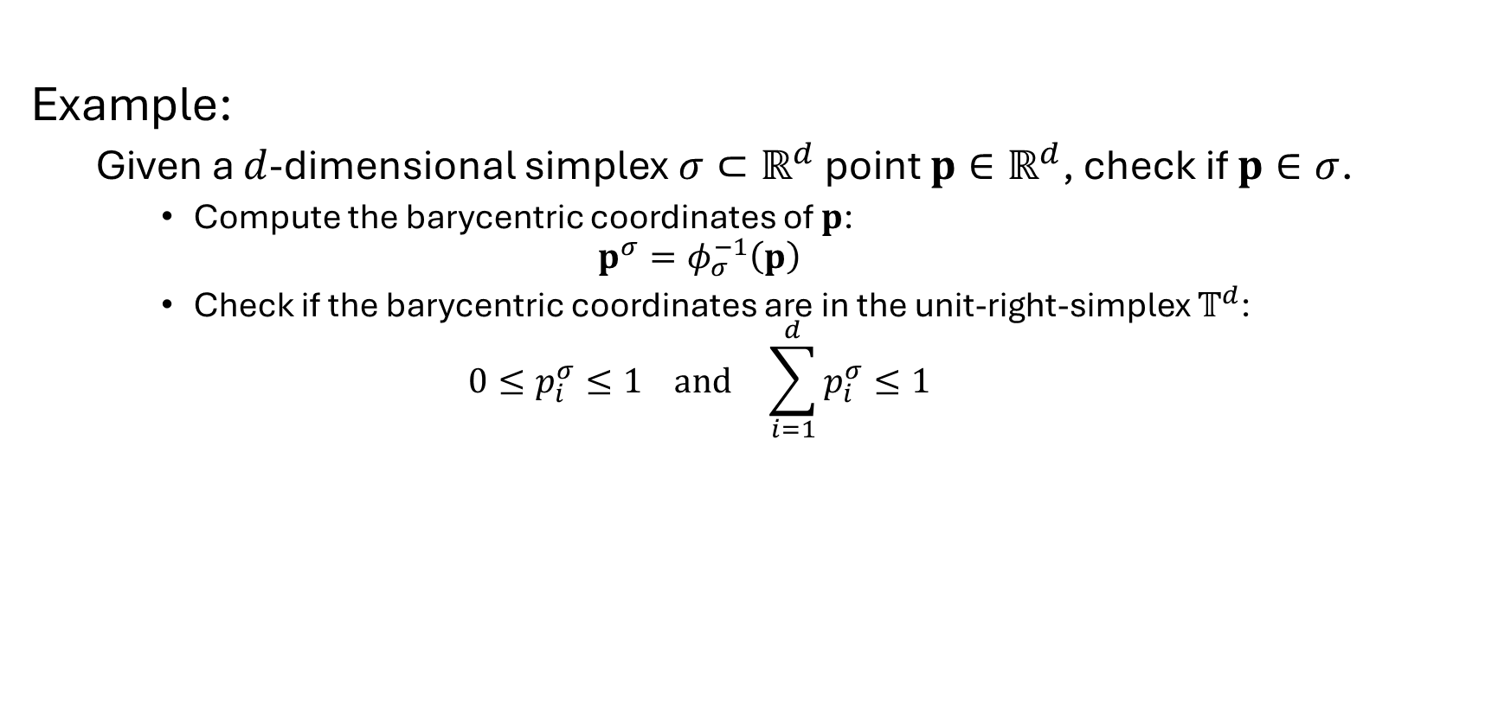









Review: barycentric coordinates
Example:
Given a $d$-dimensional simplex $σ⊂ℝ^{d}$ point $p∈ℝ^{d}$, check if $p∈σ$.
Compute the barycentric coordinates of $p$: $p^{σ}=φ_{σ}^{−1}\left(p\right)$
Check if the barycentric coordinates are in the unit-right-simplex $𝕋^{d}$: $0≤p_{i}^{σ}≤1 and \sum_{i=1}^{d}{p_{i}^{σ}}≤1$
$$v_{2}$$
$$(0,1)$$
$$q^{σ}$$
$$φ_{σ}$$
$$q$$
$$p^{σ}$$
$$p$$
$$(0,0)$$
$$(1,0)$$
$$v_{1}$$
$$v_{0}$$
Notes:
$$q=A^{−1}⋅(p−p_{0})$$

Slide 9
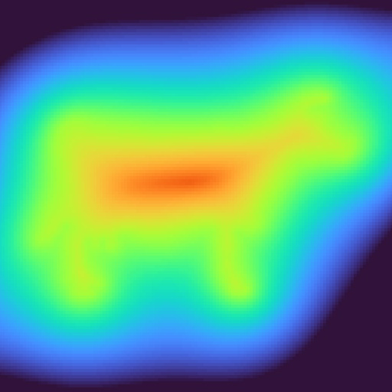

Goal (analytic)
Input:
A real-valued function, $g:{\left[0,1\right]}^{2}→ℝ$
A real level-set-value, $α∈ℝ$

Slide 10
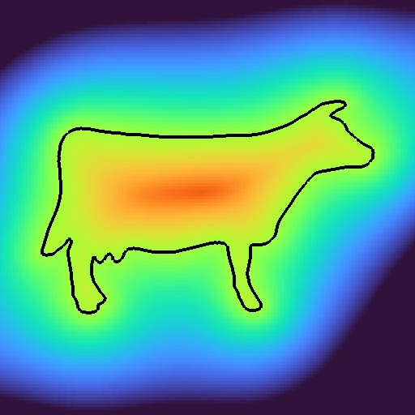

Goal (analytic)
Input:
A real-valued function, $g:{\left[0,1\right]}^{2}→ℝ$
A real level-set-value, $α∈ℝ$
Output:
The $α$ level-set of $g$:
$$g^{−1}\left(α\right)=\left\{p∈{\left[0,1\right]}^{2} | g\left(p\right)=α\right\}$$

Slide 11
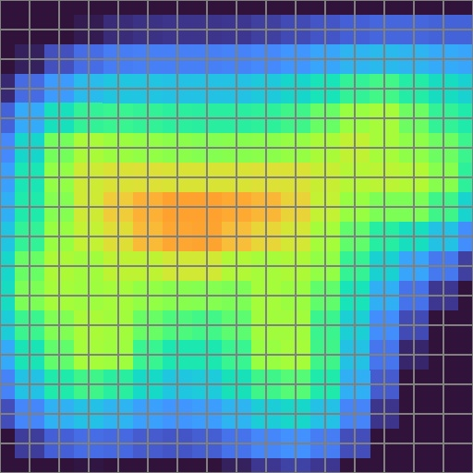

Goal (discrete)
Input:
A regular real-valued 2D grid, $g∈ℝ^{N×N}$, with values at corners
A real level-set-value, $α∈ℝ$

Slide 12
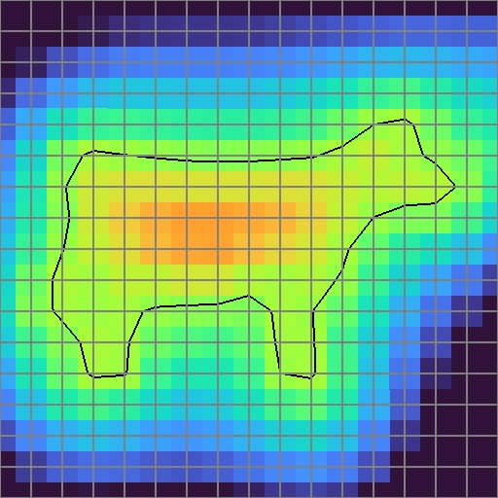
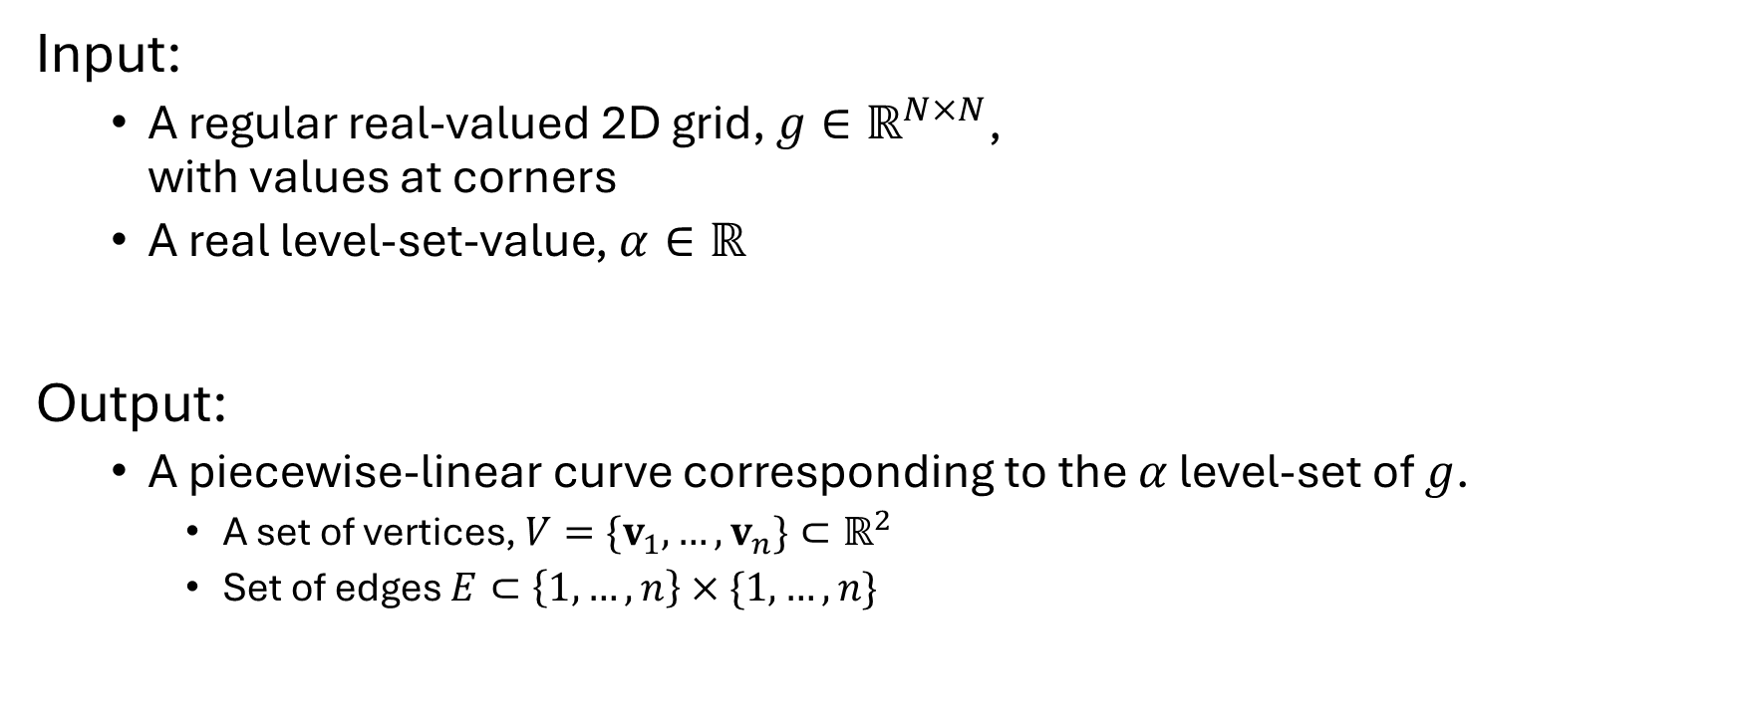

Goal (discrete)
$$α=−0.005$$
Input:
A regular real-valued 2D grid, $g∈ℝ^{N×N}$, with values at corners
A real level-set-value, $α∈ℝ$
Output:
A piecewise-linear curve corresponding to the $α$ level-set of $g$.
A set of vertices, $V=\{v_{1},…,v_{n}\}⊂ℝ^{2}$
Set of edges $E⊂\left\{1,…,n\right\}×\{1,…,n\}$

Slide 13
Approach
Interpolate the function’s values from the corners.
Independently extract the level-set from each cell.
Observation:
If the interpolated function is continuous, the per-cell level-sets will match seamlessly.
Challenge:
How to interpolate from corners?

Slide 14

Challenge
Q: How to interpolate from corners?
A: Nearest interpolation
Not continuous

Slide 15


Challenge
Q: How to interpolate from corners?
A: Bi-linear interpolation
$$f\left(x,y\right)=\left(1−x\right)⋅\left(1−y\right)f_{00} \\ +\left(1−x\right)⋅y⋅f_{01} \\ +x⋅\left(1−y\right)⋅f_{10} \\ +x⋅y⋅f_{11}$$

Slide 16
Challenge
Q: How to interpolate from corners?
A: Bi-linear interpolation
Continuous

Slide 17

Challenge
Q: How to interpolate from corners?
A: Bi-linear interpolation
Continuous
Level-sets are curved (the level-set gets more complex as the dimension of the domain is increased)

Slide 18


Challenge
Q: How to interpolate from corners?
A: Add a diagonal and linearly interpolate within each triangle $$f\left(x,y\right)=\left(1−x−y\right)⋅f_{00}+x⋅f_{10}+y⋅f_{01}$$

Slide 19
Challenge
Q: How to interpolate from corners?
A: Add a diagonal and linearly interpolate within each triangle
Continuous

Slide 20

Challenge
Q: How to interpolate from corners?
A: Add a diagonal and linearly interpolate within each triangle
Continuous
Level-sets are straight

Slide 21

Challenge
Q: How to interpolate from corners?
A: Add a diagonal and linearly interpolate within each triangle
Continuous
Level-sets are straight
Diagonal choice is arbitrary

Slide 22
Challenge
Q: How to interpolate from corners?
A: Add a diagonal and linearly interpolate within each triangle
Continuous
Level-sets are straight
Diagonal choice is arbitrary
Note:
The functions will be continuous along the shared edge between edge-adjacent triangles.

Slide 23




Implementation
$$α_{3}$$
Input:
A triangle $\left(v_{1},v_{2},v_{3}\right)$, with $v_{i}∈ℝ^{2}$
Values $\left(α_{1},α_{2},α_{3}\right)$, with $α_{i}∈ℝ$
A level-set-value $α∈ℝ$
Output:
The geometry of the $α$ level-set within the triangle
$$α_{1}$$
$$α_{2}$$

Slide 24

Implementation
$$α_{3}$$
Assuming general position, there are four cases:
$α_{1},α_{2},α_{3}>α$
$α_{i+1},α_{i+2}>0$ and $α_{i}<α$
$α_{i}>α$ and $α_{i+1},α_{i+2}<α$
$α_{1},α_{2},α_{3}<α$
$$α_{1}$$
$$α_{2}$$

Slide 25




Implementation
$$α_{3}$$
$α_{1},α_{2},α_{3}>α$:
The $α$ level-set does not pass through the triangle
$$α_{1}$$
$$α_{2}$$

Slide 26
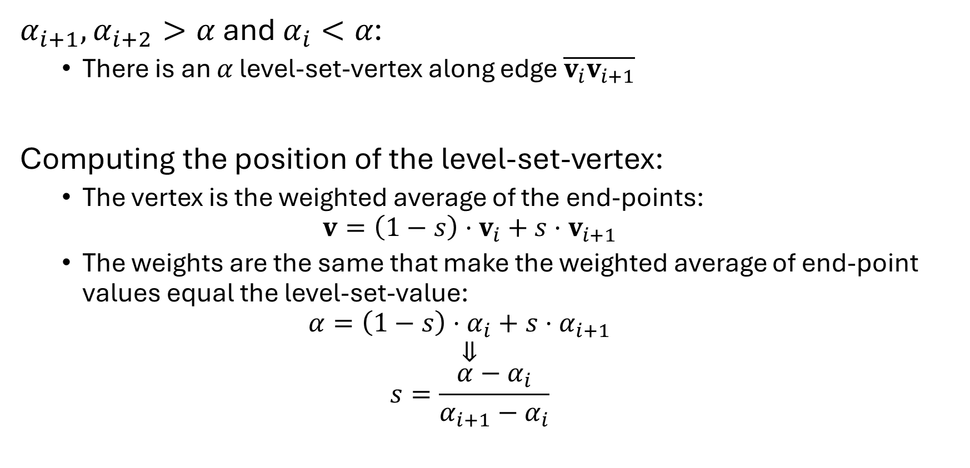

Implementation
$$α_{3}$$
$α_{i+1},α_{i+2}>α \text{and} α_{i}<α$:
There is an $α$ level-set-vertex along edge $\overline{v_{i}v_{i+1}}$
Computing the position of the level-set-vertex:
The vertex is the weighted average of the end-points: $v=\left(1−s\right)⋅v_{i}+s⋅v_{i+1}$
The weights are the same that make the weighted average of end-point values equal the level-set-value: $α=\left(1−s\right)⋅α_{i}+s⋅α_{i+1}$
$$⇓$$
$$s=\frac{α−α_{i}}{α_{i+1}−α_{i}}$$
$$α_{1}$$
$$α_{2}$$

Slide 27

Implementation
$$α_{3}$$
$α_{i+1},α_{i+2}>α \text{and} α_{i}<α$:
There is an $α$ level-set-vertex along edge $\overline{v_{i}v_{i+1}}$
There is an $α$ level-set-vertex along edge $\overline{v_{i}v_{i+2}}$
$$α_{1}$$
$$α_{2}$$

Slide 28

Implementation
$$α_{3}$$
$α_{i+1},α_{i+2}>α \text{and} α_{i}<α$:
There is an $α$ level-set-vertex along edge $\overline{v_{i}v_{i+1}}$
There is an $α$ level-set-vertex along edge $\overline{v_{i}v_{i+2}}$
There is an $α$ level-set-edge connecting the level-set-vertices
$$α_{1}$$
$$α_{2}$$

Slide 29


Implementation
$$α_{3}$$
$α_{i}>α$ and $α_{i+1},α_{i+2}<α$:
There is an $α$ level-set-vertex along edge $\overline{v_{i}v_{i+1}}$
There is an $α$ level-set-vertex along edge $\overline{v_{i}v_{i+2}}$
There is an $α$ level-set-edge connecting the level-set-vertices
$$α_{1}$$
$$α_{2}$$

Slide 30


Implementation
$$α_{3}$$
$α_{1},α_{2},α_{3}<α$:
The $α$ level-set does not pass through the triangle
$$α_{1}$$
$$α_{2}$$

Slide 31
Implementation
$$α_{3}$$
Technical details:
Represent the geometry by having edges store vertex indices, not positions.
$$α_{1}$$
$$α_{2}$$

Slide 32
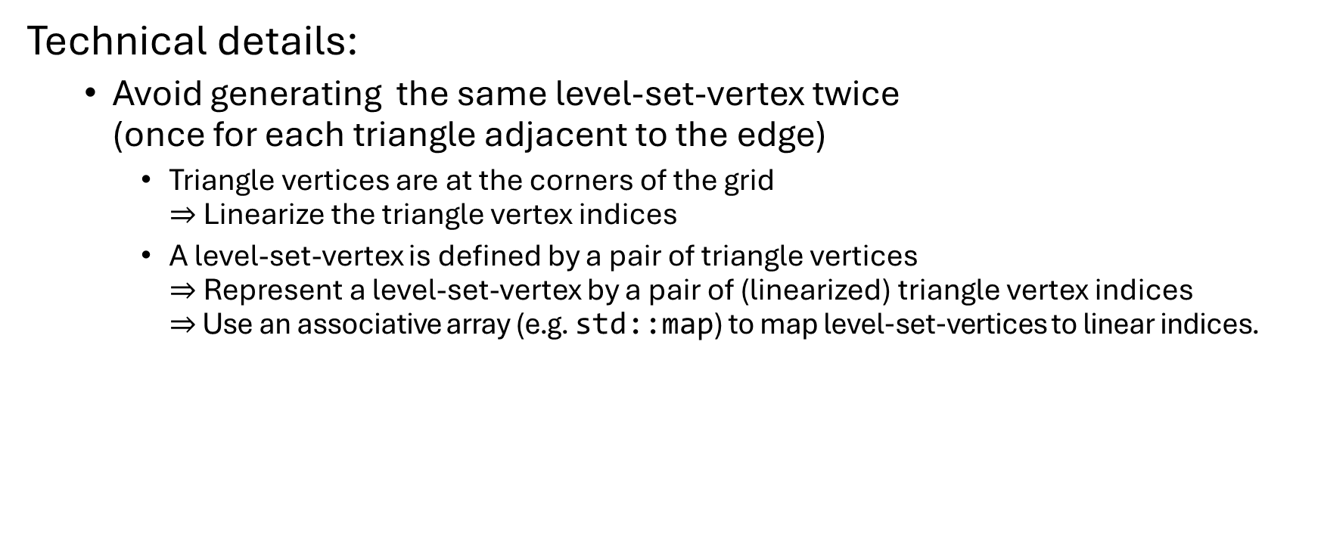
Implementation
$$α_{3}$$
Technical details:
Avoid generating the same level-set-vertex twice (once for each triangle adjacent to the edge)
Triangle vertices are at the corners of the grid $⇒$ Linearize the triangle vertex indices
A level-set-vertex is defined by a pair of triangle vertices $⇒$ Represent a level-set-vertex by a pair of (linearized) triangle vertex indices $⇒$ Use an associative array (e.g. std::map) to map level-set-vertices to linear indices.
$$α_{1}$$
$$α_{2}$$

Slide 33

Implementation
$$α_{3}$$
Technical details:
Orient the edges consistently (e.g. so that the corners values less than $α$ are always on the left)
$$α_{1}$$
$$α_{2}$$

Slide 34






Implementation
Technical details:
Perform the calculation over the unit-right-simplices
$⇒$ Gives the position of the vertices in barycentric coordinates
Transform barycentric coordinates to world coordinates
$$(0,1)$$
$$0$$
$$1$$
$$(0,0)$$
$$(1,0)$$

Slide 35

Inductive triangulation
By induction:
Decompose a $d$-dimensional into $d!$ $d$-dimensional simplices.

Slide 36

Inductive triangulation
Base case $d=2$:
Triangulate the square by adding the diagonal from the origin to the opposite corner
$⇒$ $2$-dimensional cube $→$ $2!$ simplices

Slide 37

Inductive triangulation
Base case $d=2$:
Triangulate the square by adding the diagonal from the origin to the opposite corner
$⇒$ $2$-dimensional cube $→$ $2!$ simplices
Inductive case:
Triangulate the $d$ faces incident on the origin
$⇒$ $d!$ $\left(d−1\right)$-dimensional simplices

Slide 38

Inductive triangulation
Base case $d=2$:
Triangulate the square by adding the diagonal from the origin to the opposite corner
$⇒$ $2$-dimensional cube $→$ $2!$ simplices
Inductive case:
Triangulate the $d$ faces incident on the origin
Fuse each $(d−1)$-dimensional simplex with the point antipodal from the origin

Slide 39

Inductive triangulation
Base case $d=2$:
Triangulate the square by adding the diagonal from the origin to the opposite corner
$⇒$ $2$-dimensional cube $→$ $2!$ simplices
Inductive case:
Triangulate the $d$ faces incident on the origin
Fuse each $(d−1)$-dimensional simplex with the point antipodal from the origin

Slide 40
Inductive triangulation
Base case $d=2$:
Triangulate the square by adding the diagonal from the origin to the opposite corner
$⇒$ $2$-dimensional cube $→$ $2!$ simplices
Inductive case:
Triangulate the $d$ faces incident on the origin
Fuse each $(d−1)$-dimensional simplex with the point antipodal from the origin

Slide 41
Inductive triangulation
Base case $d=2$:
Triangulate the square by adding the diagonal from the origin to the opposite corner
$⇒$ $2$-dimensional cube $→$ $2!$ simplices
Inductive case:
Triangulate the $d$ faces incident on the origin
Fuse each $(d−1)$-dimensional simplex with the point antipodal from the origin

Slide 42
Inductive triangulation
Base case $d=2$:
Triangulate the square by adding the diagonal from the origin to the opposite corner
$⇒$ $2$-dimensional cube $→$ $2!$ simplices
Inductive case:
Triangulate the $d$ faces incident on the origin
Fuse each $(d−1)$-dimensional simplex with the point antipodal from the origin

Slide 43
Inductive triangulation
Base case $d=2$:
Triangulate the square by adding the diagonal from the origin to the opposite corner
$⇒$ $2$-dimensional cube $→$ $2!$ simplices
Inductive case:
Triangulate the $d$ faces incident on the origin
Fuse each $(d−1)$-dimensional simplex with the point antipodal from the origin

Slide 44

Inductive triangulation
Base case $d=2$:
Triangulate the square by adding the diagonal from the origin to the opposite corner
$⇒$ $2$-dimensional cube $→$ $2!$ simplices
Inductive case:
Triangulate the $d$ faces incident on the origin
Fuse each $(d−1)$-dimensional simplex with the point antipodal from the origin
$⇒$ $d$-dimensional cell $→$ $d!$ simplices

